Slide 1
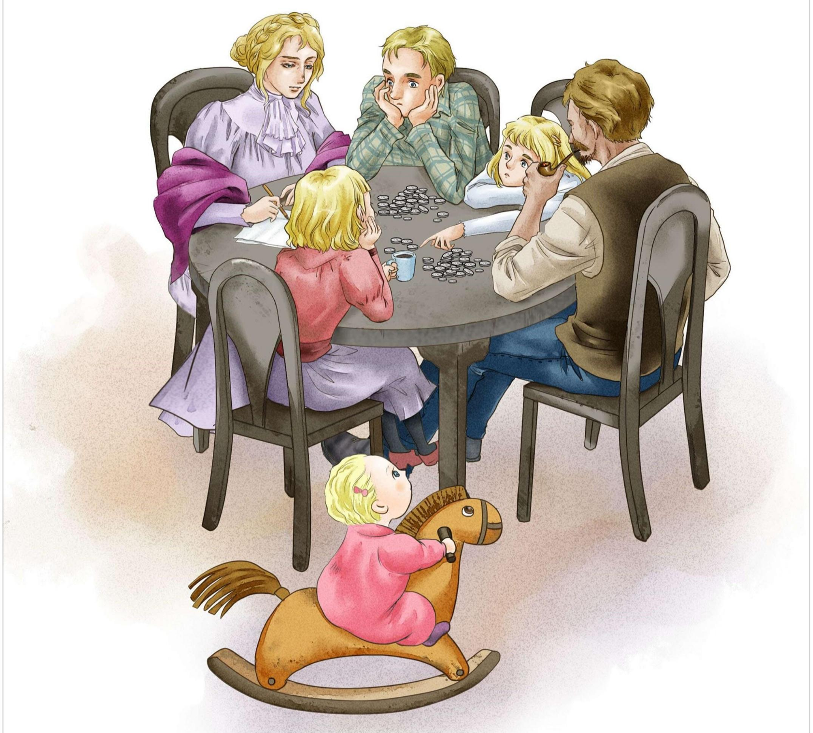
Mama and Her Bank Account
ACTION!

Slide 2

Language Points

Slide 3
Scene 1
Mama and Her Bank Account
账户
Every Saturday night Mama would sit down by the kitchen table and count out the money Papa had brought home.
“For the rent.” Mama would count out the big silver pieces.
“For the groceries.” Another group of coins.
“I’ll need a notebook.” That would be my sister Christine, my brother Nels or me.
清点
房租
食品杂货

Slide 4
Scene 1
Mama would put one or two coins to the side. We would watch with anxious interest. At last, Papa would ask, “Is that all?” And when Mama nodded, we could relax a little. Mama would look up and smile, “Good. We do not have to go to the Bank.” We were all so proud of Mama’s Bank Account. It gave us such a warm, secure feeling.
怀着热切的兴趣看着
点头
向上看
对...骄傲

Slide 5
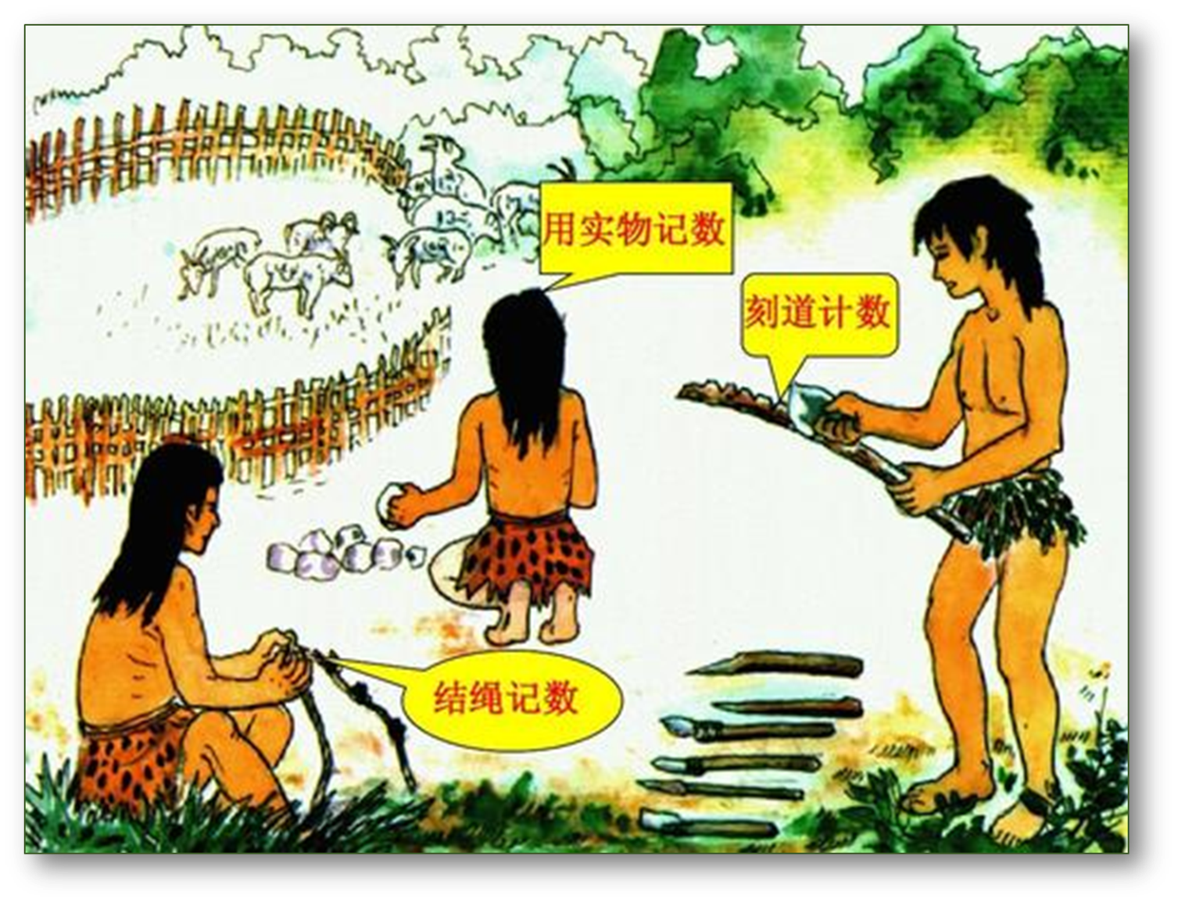
1. account
account源自古法语，由“ac-（to）+ -count（计算）”构成，account的词源义是“计数”，其基本义是“记录”。 “计数”本质上就是 “记录”。
在文字发明以前，为了适应表达和记忆的需要，人类用“刻道计数”和“结绳记事”等方法来计数或记录事件。

Slide 6
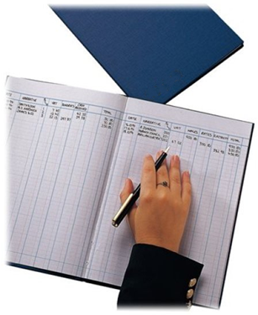
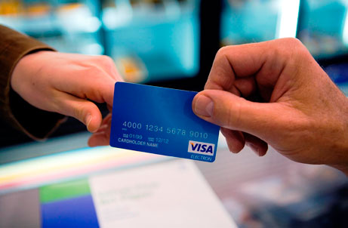
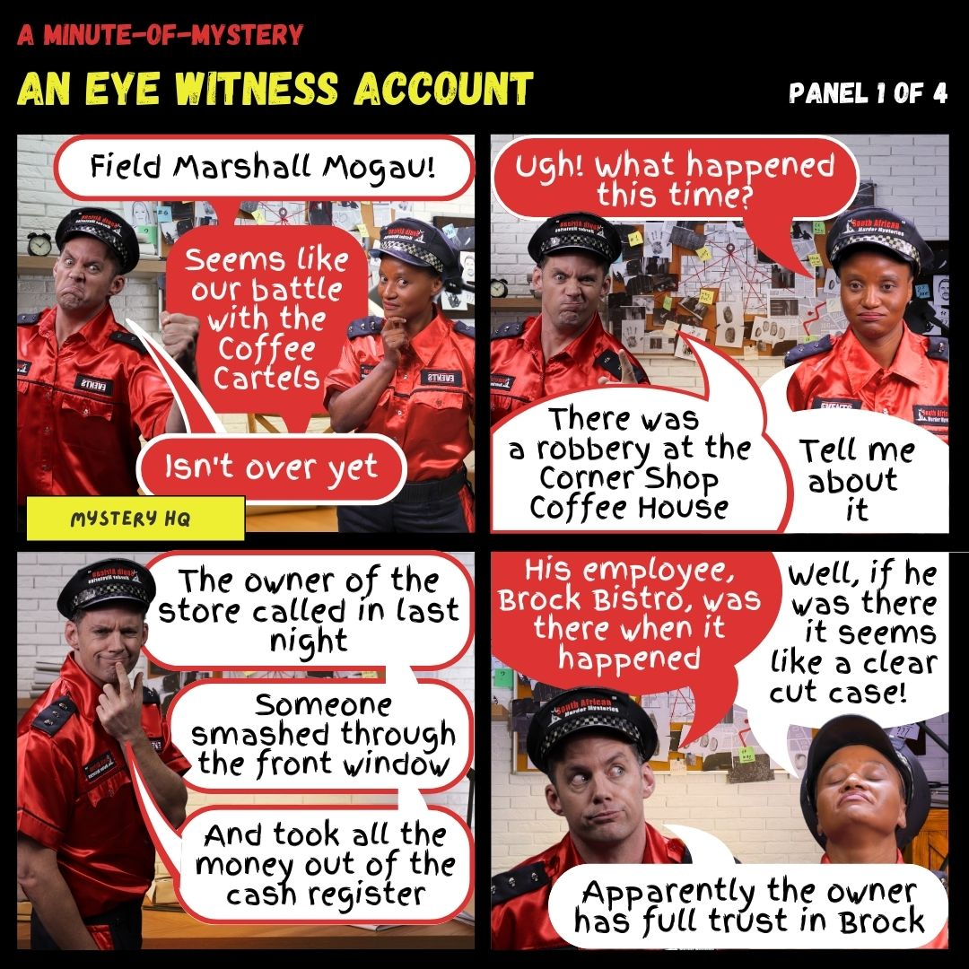
1. account n [C]
❶ [常用复数] 账；账目：
an account book 账簿
❷ 账户；账号：
open / close an account 开/销户
❸ 叙述；报道；描写：
an eye-witness account of a murder
目击证人对谋杀案的描述

Slide 7
account的语义网络图
资金往来的“记录”
账；账目
记录
（基本义）
进行银行交易、使用网络等时个人信息的“记录”
账户；账号
事件的“记录”
叙述；报道；描写

Slide 8
【词组搭配】on account of； on no account； take account of
on account of 因为；由于 (because of)：
She was absent from school on account of illness.
on no account 决不；绝对不：
On no account can we give up.
take account of / take ... into account 考虑到；把……考虑进去:
One must take the audience into account when making speeches.
注：on no account置于句首，其所在的句子要用倒装语序。

Slide 9
【词组搭配】account for v.
❶（数量、比例上）占：
It is said that body language accounts for 55 percent of a first impression while what you say just 7 percent.
❷ 是……的原因；解释 / 说明 (explain)：
The application of new technologies could account for the increase of the box office income.
【词汇拓展】
accountant n [C] 会计（员）；会计师

Slide 10
2. rent
❶ n. 租金
pay the rent 付租金 a high/low/fair rent 高的/低的/合理的租金
for rent 出租，招租
❷ vi.&vt. 租用；出租
rent sth. from sb. 从某人处租某物
rent sth. (out) to sb. 把某物租给某人
rent at/for... 以...的价格出租，租金为...
Generally, houses in this area rent at 3,000 yuan a month.
一般来说，这个地区的房子租金为每月3000元。

Slide 11
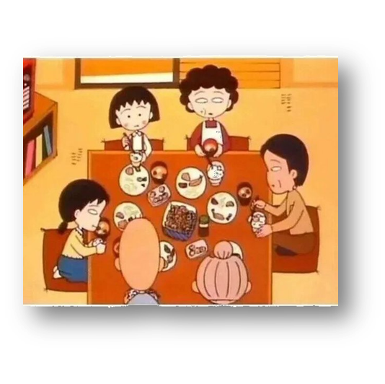
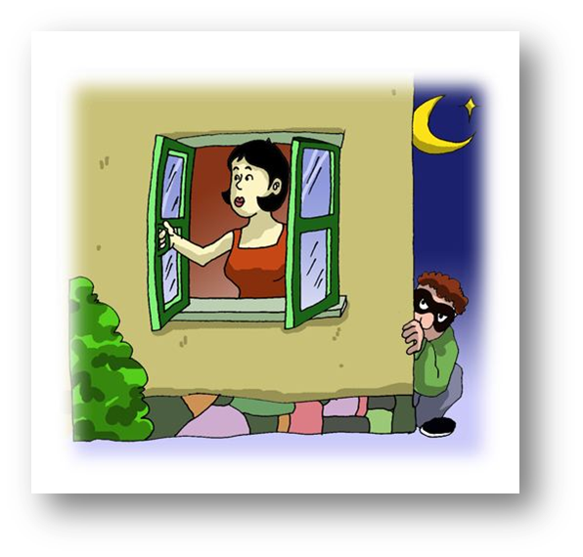
be secure against/from 免受...
3. secure adj.
❶ 安心的；有把握的：
She felt secure when she was with her family.
❖ 安全的 (safe)；稳妥的；可靠的：
a secure job / income
⬥ 牢固的；坚固的；稳固的：
Check that all windows and doors are secure.
Keep your passport in a secure place.

Slide 12
形容词动词化
3. secure vt.
secure 动词释义来源于形容词，其词源义及基本义为 “to make safe”，即“使安全”。
◆ 使安全；保卫；获得：
Worrying about community safety, I prefer to secure my house with new technology.
由于担心社区安全，我宁愿用新技术来保护我的房子。
❖ 使……固定：
He secured the rope firmly to the back of the car.
他把绳子牢牢地系在汽车后面。

Slide 13
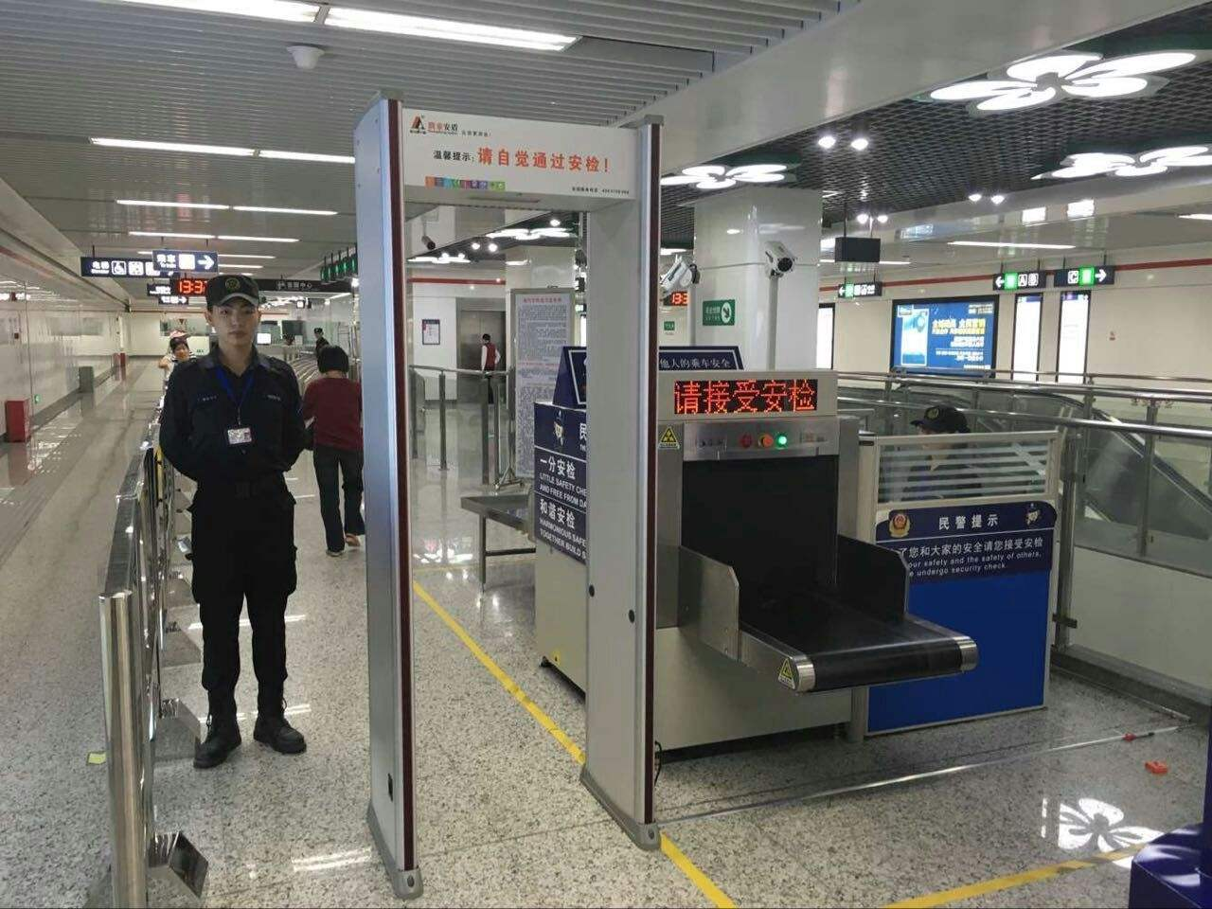

security n.
看图
猜词
security check
security guard
安检
保安人员

Slide 14



security n
❶ [U] 安全：
a sense of security 一种安全感
❖ [U] 安全工作；保安措施：
security checks / cameras
⬥ [U] 担保；保障；[U] & [C] 抵押品：
financial security 财产保障

Slide 15
Scene 2
When Nels graduated from grammar school, he wanted to go on to high school. “It will cost a little money,” he said.
Eagerly we gathered around the table. I took down a box and laid it carefully in front of Mama. This was the “Little Bank”. It was used for sudden emergencies, such as the time when Christine broke her arm and had to be taken to a doctor.
从...毕业
渴望地
聚集围坐
取下
放置
被用来
突发事件

Slide 16
Scene 2
列出
Nels listed the costs of the things he would need. Mama counted out the money in the Little Bank. There was not enough. “We do not want to go to the Bank,” she reminded. We all shook our heads.
“I will work in Dillon’s grocery after school,” Nels volunteered.
提醒
摇头
主动提出

Slide 17
Scene 2
Mama gave him a bright smile and wrote down a number. “That’s not enough,” Papa said. Then he took his pipe out of his mouth and looked at it for a long time. “I will give up smoking,” he said suddenly.
Mama reached across the table and touched Papa’s arm. Then she wrote down another figure.
给了他一个灿烂的微笑
写下
把...从...中取出
注视...
跨越；伸过
数字

Slide 18
Scene 2
照顾
“I will look after the Elvington children every Friday night,” I said. “Christine can help me.”
Now there was enough money. We all felt very good because we did not have to go downtown and draw money out of Mama’s Bank Account.
市中心
从...取钱

Slide 19
Scene 2
So many things came out of the Little Bank that year: Christine’s dress for the school play, my little sister Dagmar’s operation ... Whatever happened, we always knew we still had the Bank to depend upon.
That was twenty years ago.
手术

Slide 20
4. graduate v.
词源： -grad- (grade 步 / 级) + -u- + -ate 名词词尾 → 在学业上完成某一步 / 某一级 → 毕业。同根词：grade，gradual。
◆ vi 获得学位；毕业：
He graduated in physics from Cambridge University.
他毕业于剑桥大学物理系。
❖ vt 使……毕业；授予……学位：
The college graduated 500 students last year.
⬥ vi 逐渐升级为：
I quickly graduated from typical children’s books to ones with fewer pictures and longer chapters.

Slide 21

■ n [C] 学位获得者；毕业生：
a high school graduate 中学毕业生
a graduate of... ...(学校)的毕业生
【词汇拓展】
graduation n
◆ [U] 毕业：
a graduation certificate 毕业证书
❖ [U] & [C] 毕业典礼：
attend the graduation

Slide 22
基本义：使集中
5. gather
◆ vi & vt (使) 聚集；(使) 聚拢：
We’ll gather at the Students’ Club at 8 p.m. this Friday.
❖ vt 搜集；采集 (collect)；[正式用语] 收 (庄稼等)：
Bees gather honey. 蜜蜂采蜜
⬥ vt 增加；vi 渐增；积聚：
gather speed 加快速度
❹ 推测；认为：
I gather from your letter that you’ re not enjoying your job.
◆ gathering n [C] 聚会；集会

Slide 23
gather的语义网络图
使人“集中”
（使）聚集；（使）集合
使分散的东西“集中”
收拢；归拢
（使）集中
gather
（词源义）
使植物、庄稼等“集中”
采集；收割（庄稼等）
使已知事物“集中”，产生想法
推测；认为

Slide 24
6. emergency n. 突发事件，紧急情况
for emergencies
the emergency exit
take emergency action
emergency supplies
an emergency landing
以备急需
救援物资
紧急出口
紧急着陆
采取紧急措施

Slide 25
7. volunteer
◆ vt.&vi. 主动提议（或告诉）
"We will strive to protect the environment," Mark volunteered.
“我们将努力保护环境，”马克自告奋勇。
❖ vt.&vi. 自愿做，义务做
volunteer to do/for sth. 自愿做某事
n. 志愿者
The community needs volunteers to help the disabled.
社区需要志愿者来帮助残疾人。

Slide 26

8. figure
在《圣经》中，亚当和夏娃偷吃了禁果之后，有了羞耻感，于是夏娃就想找个树叶子来遮挡自己的身体。柳树叶子太小，梧桐叶子又太大，身边正好有无花果（fig）树，就摘了无花果的叶子作为贴身短衣。
因为fig是用来遮挡身体形状的，所以figure的含义引申为“形状”。

Slide 27


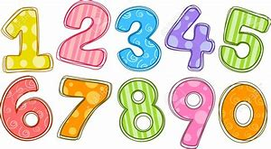
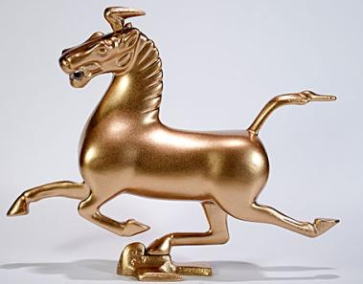

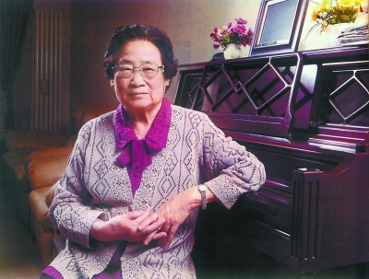
8. figure

Slide 28
8. figure
❶[常用复数]数字；位数；算术：
He got a job, earning close to six figures.
他找到了一份工作，收入接近六位数。
❷体形 / 身材 / 身影：
a tall figure in black
一个穿黑衣服的高个子

Slide 29
8. figure
❸ 人物；人士 a person who is important or famous：
a public / a leading / an authority figure
公众人物/领导人物/权威人物
❹ 画像；塑像：
a bronze figure of a horse
马的铜像
❺ 图表；图形：
See Figure 1.
参见图表1

Slide 30
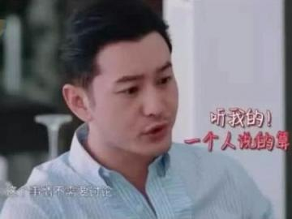
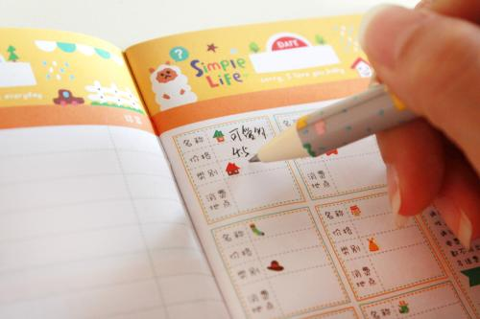
8. figure
词源：有了羞耻感的亚当和夏娃“认为”遮挡身体很重要，所以figure又引申出“是重要部分、是……的部分”的意思。
❶ vi 是重要部分；是…的部分
My feeling about the matter didn’t seem to figure at all.
我对这个问题的意见似乎根本无足轻重。
❷ vt [非正式用语] 认为；估计
That's what I figured.
❸ vt (AmE) 计算：
I’m just figuring my expenses.
figure out 弄清楚；弄明白；计算出

Slide 31
n
figure的语义网络图
数字
v
“数字”的形状
位数
是重要部分；是……的部分
算术
人物；人士
认为；估计
形状figure n
(基本义)
“人或动物”的形状
体型；身材；身影
计算
画像；塑像
“几何图形”的
形状
图表
图形

Slide 32
9. draw sth. out of sth. 提取，支取
【用法拓展】
draw sb./sth. aside
draw to a close
draw a comparision
draw a conclusion
draw (sb's) attention to sth.
draw a line between sth. and sth.
draw on/upon...
draw up...
进行比较
下结论
把...拉到一边
临近结束
划清界限，区分
利用...
使某人注意...
起草...
drawer 抽屉

Slide 33
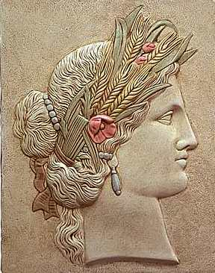
10. operation
俄普斯(Ops)的名字意思是“丰产丰富”，她的神职是“丰收之神”。operate的词根是oper，oper 受丰收之神——俄普斯(Ops)的影响，表示“工作”。operate的词源义即为“工作 (to work, labor)”。随着社会的进步和科技的发展，它的释义变得更加丰富，出现了“动手术”“操作”等用于医疗、工业机械、计算机等领域的释义。虽然这些释义变化较大，但是都和词源义之间有着紧密的联系。

Slide 34

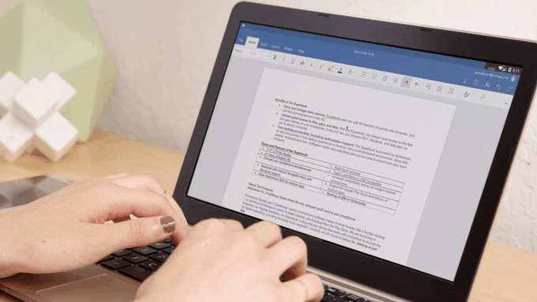
10. operate & operation
❶ vi & vt (使) 运行；(使) 运转 to work or make sth work：
Can you explain how the machine operates?
❖ vt 操作；使用 to use and control a machine or equipment：
This machine is very easy to operate.

Slide 35

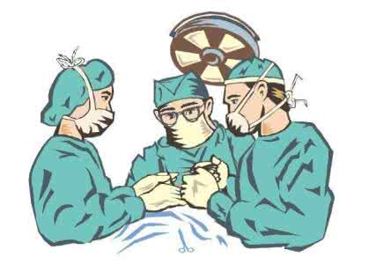

10. operate & operation
⬥ vi 起作用；奏效 to act or have an effect：
The medicine began to operate at once.
❹ vi 动手术；开刀 ：
Having seen the X-ray, the doctor decided to operate on the patient.
❺ vt 经营；管理：
operate a restaurant / company

Slide 36
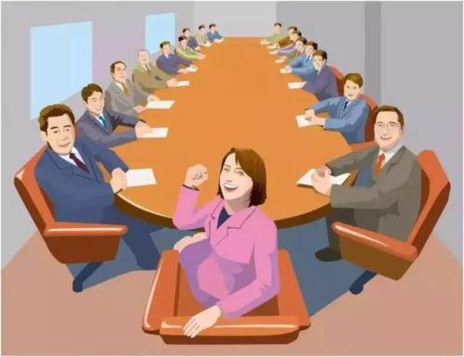

10. operation
通过查询词源可以发现，operate来源于operation。这种构词法 (back-formation) 也叫作逆生法。逆生法与词缀法的构词方式正好相反，它通过截去一个词的词缀或被误认为词缀的成分构成一个更短的新词。
operation n
❶ [U] 运行；运转；操作：
in operation 运转中，使用中
❷ [C] & [U] 经营；运营：
go / come into operation 开始运营
⬥ [C] 企业；团体 a business company：
a huge multinational electronics operation
一家大型跨国电子公司

Slide 37
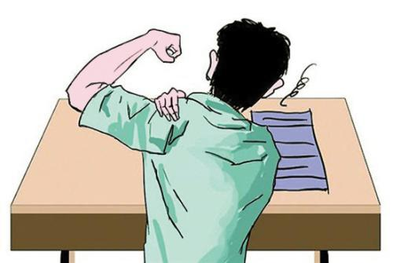
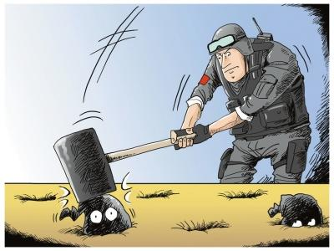

10. operation
❹ [C] 手术：
He’s recovering from an operation on his shoulder.
❺ [C] 行动
The police have launched a major operation against drug.
❻ [C] (计算机的) 运算；操作：
perform various mathematical operations
常用搭配
put ... into operation 实施；使……运转；启用：

Slide 38
operate & operation的语义网络图
operate
operation
机器工作
(使)运行；(使) 运转
运行；运转；操作
人使设备工作
操作；使用
经营；运营
工作
operate
基本义
企业；团体
工作产生的作用
起作用；奏效
手术
医护人员工作
动手术；开刀
行动
政企人员工作
经营；管理
(计算机的) 运算；操作

Slide 39
Scene 3
Last year I sold my first story. When the check came, I hurried over to Mama’s and put it in her lap. “For you,” I said, “to put in your Bank Account.”
I noticed for the first time how old Mama and Papa looked. Papa seemed shorter, and Mama’s hair was silver now.
支票
匆忙赶到
大腿面；膝上
注意到；发现

Slide 40
Scene 3
“Tomorrow,” I told Mama, “you must take it to the Bank.”
“You will go with me, Katrin?”
“That won’t be necessary. Just hand it to the teller. He’ll pay it into your account.”
Mama looked at me. “There is no account,” she said. “In all my life, I’ve never been inside a bank.”
出纳员

Slide 41
Scene 3
And when I didn’t—couldn’t—answer, Mama said seriously,
“It is not good for little ones to be afraid—to not feel secure.”
(Adapted from Kathryn Forbes’s Mama’s Bank Account, which has 17 short stories and describes the struggles and dreams of a family in San Francisco in the early 1900s)
改编自

Slide 42
Project (P27)
Act 1, Scene 1
Friday evening. The living room of a flat. A teenage girl, Eve, is sitting on the sofa and texting on her mobile phone when her dad enters.
Dad: I’m home! (He waits for a response but doesn’t get one. He puts his bag on the table.) Eve, how was your day?
场景
公寓
回应

Slide 43
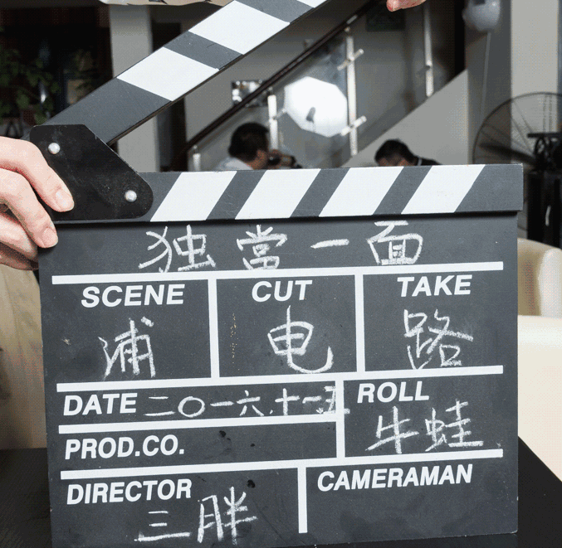

11. scene
场记板是上面写着场次(scene)、镜次、导演、片名、影片公司等资料的小木板。一端可以开合，打板时发出清脆的响声，以便剪接时使用。

Slide 44
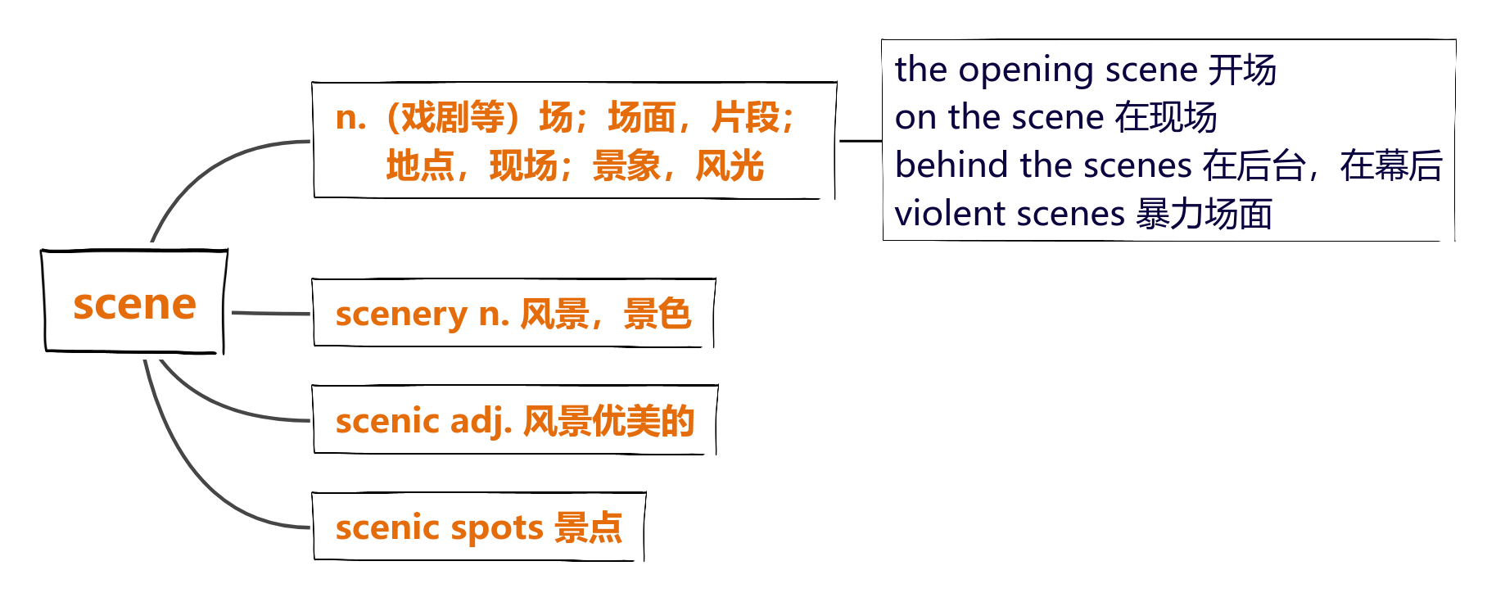

11. scene

Slide 45
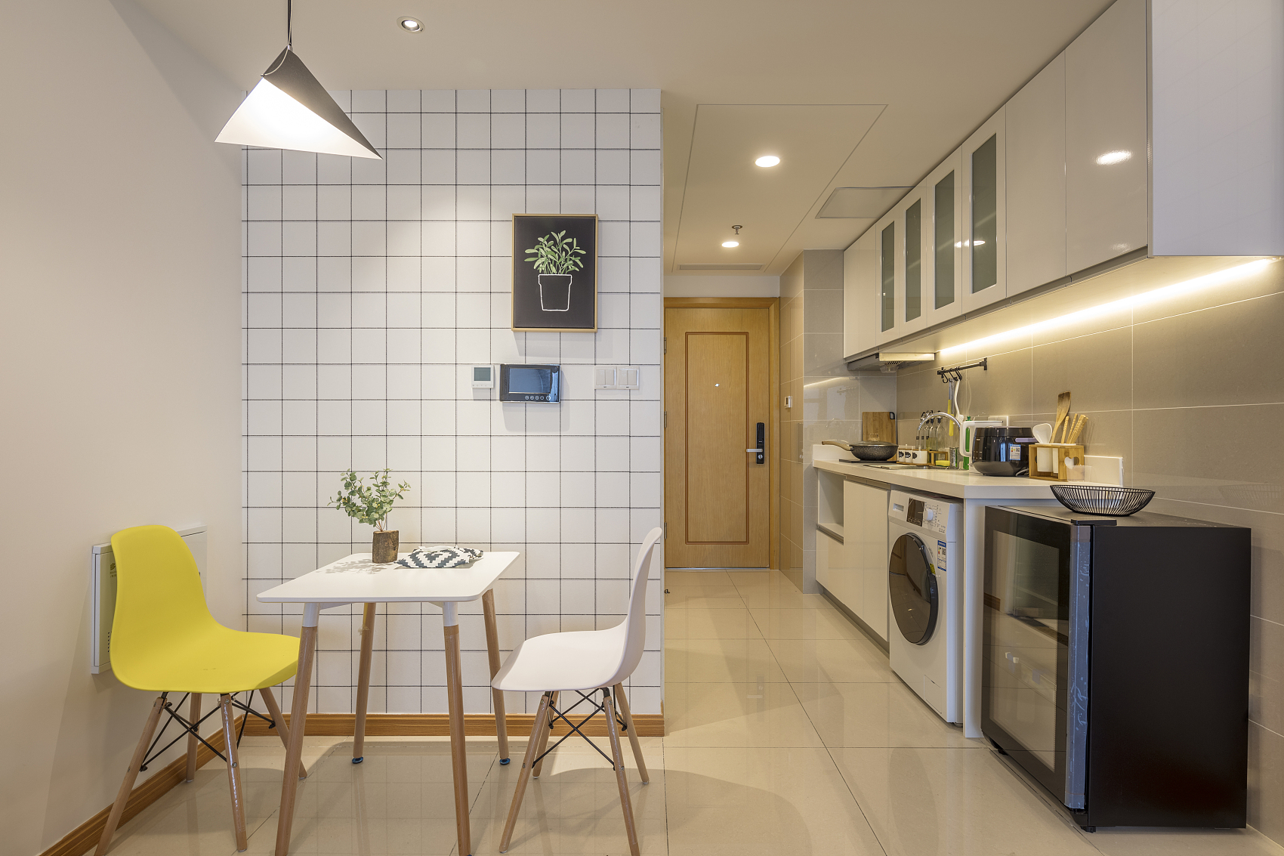
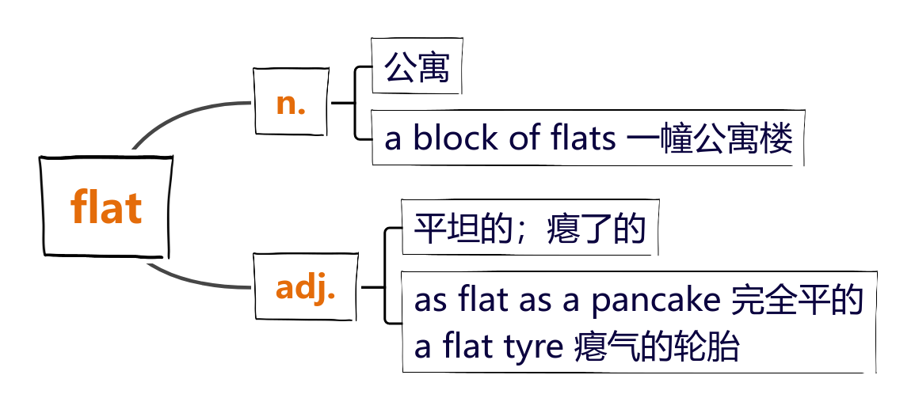
12. flat

Slide 46
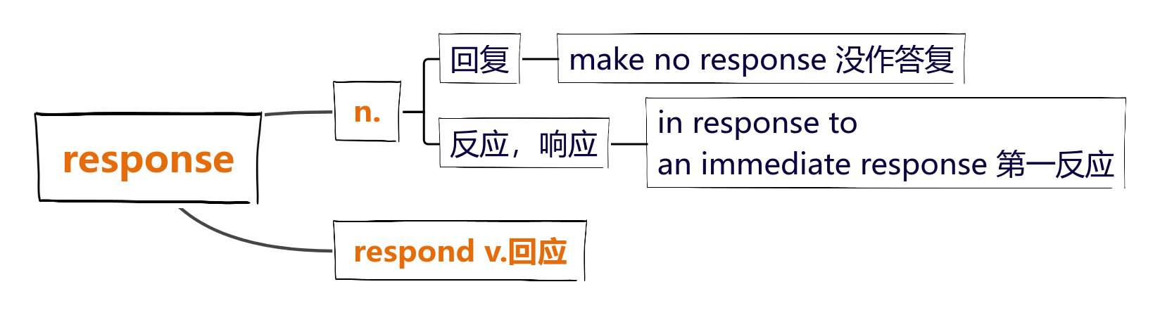
13. response

